Slide 1


Slide 2
Salary prediction using Machine learning
PRESENTED BY :-
DIKSHIT CHAUDHARY
DIVESH YADAV
COURSE :- B.TECH CSE IBM

Slide 3
INTRODUCTION
Salary prediction is a real-world application of machine learning.
Companies analyze employee data to estimate salary.
Machine learning models can identify patterns in data.
These patterns help predict salary based on employee attributes.

Slide 4
PROBLEM STATEMENT
Predict employee salary using historical data.
Traditional analysis is time-consuming and less accurate.
Machine learning models can automate this process.
The goal is to build an accurate salary prediction model.

Slide 5
OBJECTIVES
Analyze employee salary dataset.
Perform data preprocessing.
Train multiple regression models.
Compare model performance.
Predict employee salary using ML.

Slide 6
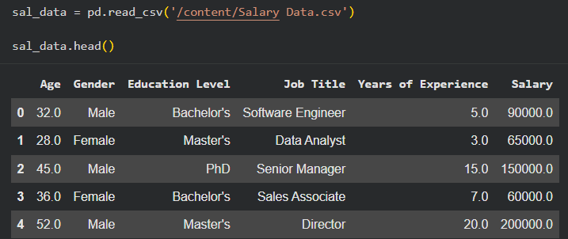
DATASET DESCRIPTION
Dataset features include:
Age
Gender
Degree
Job Title
Experience Year
Salary (Target Variable)
These attributes help predict employee salary.

Slide 7
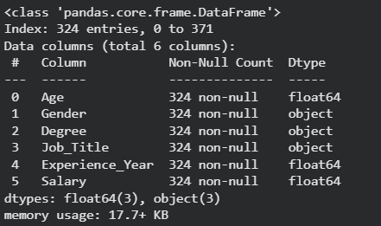
DATA PREPROCESSING
Removed duplicate records.
Handled missing values.
Encoded categorical variables.
Applied feature scaling using StandardScaler.
Prepared dataset for model training.

Slide 8
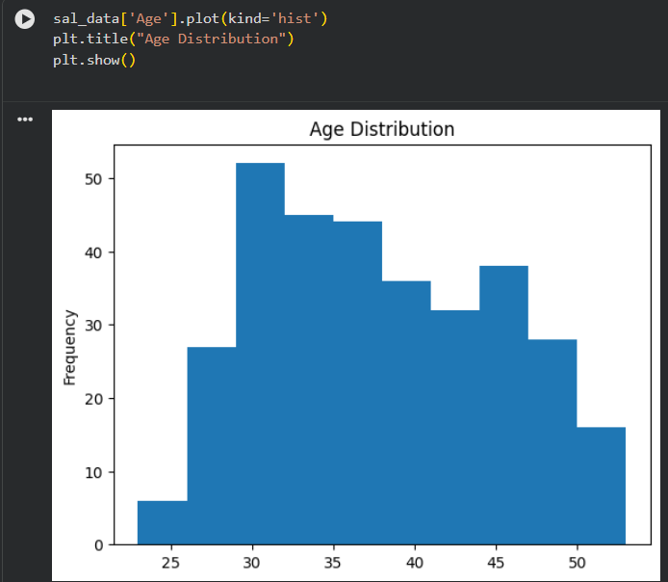
EXPLORATORY DATA ANALYSIS
Visualized data distribution.
Analyzed age distribution.
Analyzed gender distribution.
Examined degree distribution.
EDA helps understand patterns in data.

Slide 9
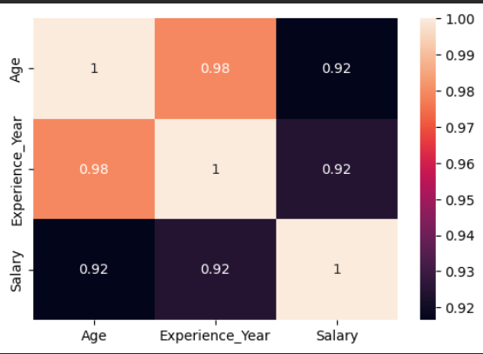
CORRELATION ANALYSIS
Correlation analysis identifies relationships between variables.
Heatmap visualization was used.
Shows relationship between age, experience, and salary.

Slide 10
MACHINE LEARNING MODEL
Models used in this project:
Linear Regression
Decision Tree Regression
Random Forest Regression
These models were trained and tested using the dataset.

Slide 11

MODEL EVALUATION
Models were evaluated using:
R² Score
Mean Absolute Error (MAE)
Root Mean Squared Error (RMSE)
These metrics help determine the best model.

Slide 12
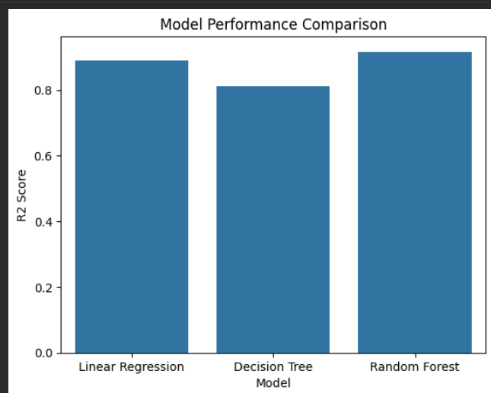
MODEL COMPARISON
Performance of all models was compared.
Random Forest showed better accuracy.
It captured complex relationships in the data.

Slide 13
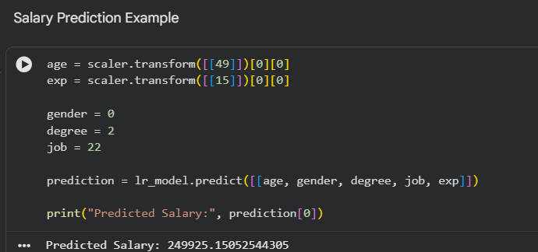
RREDICTION RESULT
Example input:
Age = 49
Gender = Male
Degree = Master
Experience = 15 years
The trained model predicts the salary based on these inputs.

Slide 14
CONCLUSION
Machine learning models can predict employee salary.
Random Forest performed best in this project.
The project demonstrates real-world ML applications.
Future Scope:
Add more features like skills and location.
Deploy model as a web application.

Slide 15


